Slide 1


GROUP K 5 EDA PROJECT PRESENTATION FACILITATOR: Ms. AKUA GHAMBAH MORGAN ACQUAH

Slide 2


Team Members
George Amofa Sarpong
James Mensah Duku
FATAWU NTORHAN
Daniel Agbenyo
Adjei-Boakye Esuako

Slide 3
OUTLINE:
A brief introduction about the data set
Tools and libraries
Hypothesis
Questions
Visualizations and insights
Conclusions

Slide 4
A brief Information about the Dataset
Video game is one the most consumed entertainment all over the world. It is consumed by both children and adults.
The dataset was a video game sales and it contains a list of video games with sales greater than 100,000 copies.
The dataset contains eleven columns in the dataset:
Rank – The overall rank of sales, Name - The games name, Platform - Platform of the games release, Year - Year of the game's release, Genre - Genre of the game, Publisher - Publisher of the game, N.A Sales - Sales in North America (in millions), EU Sales - Sales in Europe (in millions), JP Sales - Sales in Japan (in millions), Other Sales - Sales in the rest of the world (in millions), Global Sales - Total worldwide sales.

Slide 5
Tools and Libraries
Numpy
Pandas
Matplotlib.pyplot
Seaborn
Counter

Slide 6
Null Hypothesis
There is no positive relationship between sales values from the various market centers and the rank of games. Meaning rank of a game is not the most contributing factor to sales.

Slide 7
Questions
What is the total sales generated from each market?
How many games published each year from 1980 to 2020?
What are the number of games published under each genre.
What are the sales generated by each Genre?
What are the top 10 platforms that generate the highest sales?
What platform does publishers publish most games?
What are the top 10 publishers in terms of sales?
What is the top 10 most published game?
What are the top 10 games in terms of sales?

Slide 8
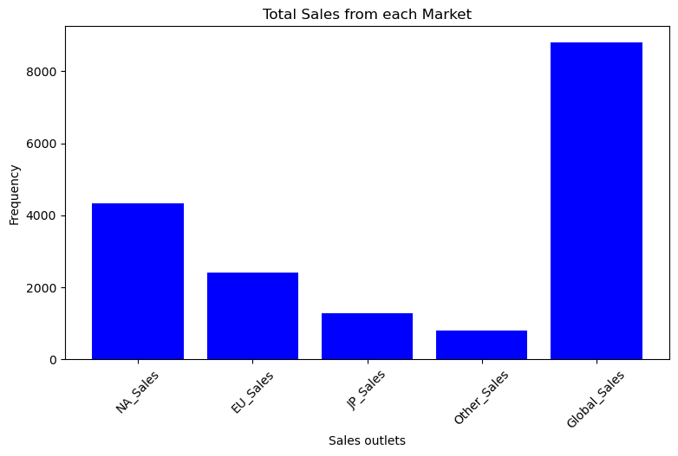
Total Sales
From the bar graph above, North American market generate the highest sales which represent something above 4 billion, followed by other markets as depicted by the bar chart.

Slide 9
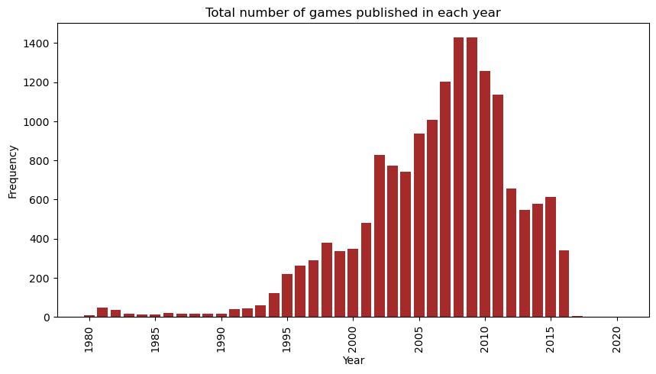
Number of games published each year
The chart depicts that most games where published in the year 2009, which constitute close to 1431 games. The second most is 2010 and it follows as depicted by the chart. The year with least games is 2020 which was 1 from our analysis

Slide 10
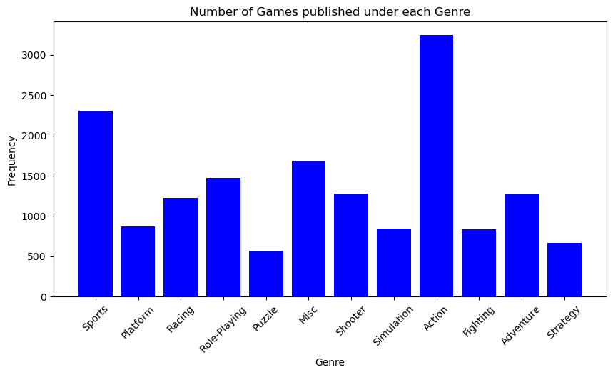
Number of games published by each genre

Slide 11
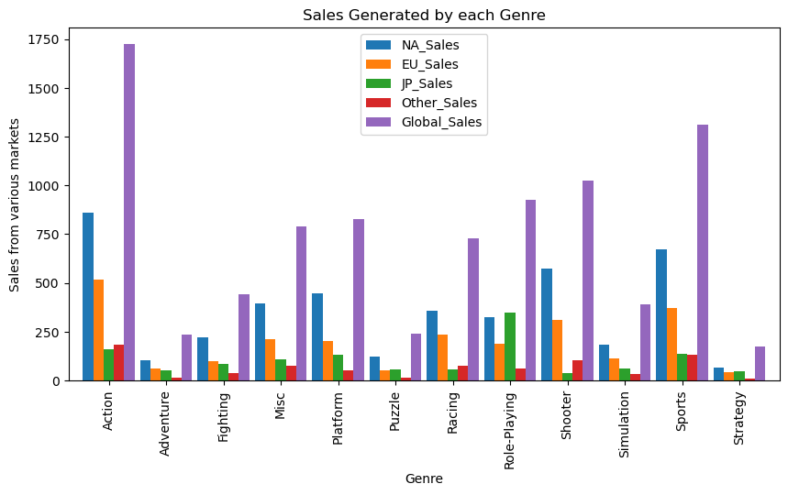
Sales generated by each Genre
From the chart , it can be inferred that among all the genres, action genre generate the highest sales across all market centers.

Slide 12
Correlation output
 | Rank | NA_Sales | EU_Sales | JP_Sales | Other_Sales | Global_Sales
Rank | 1.000000 | -0.400315 | -0.379137 | -0.269323 | -0.332735 | -0.426975
NA_Sales | -0.400315 | 1.000000 | 0.768923 | 0.451283 | 0.634518 | 0.941269
EU_Sales | -0.379137 | 0.768923 | 1.000000 | 0.436379 | 0.726256 | 0.903264
JP_Sales | -0.269323 | 0.451283 | 0.436379 | 1.000000 | 0.290559 | 0.612774
Other_Sales | -0.332735 | 0.634518 | 0.726256 | 0.290559 | 1.000000 | 0.747964
Global_Sales | -0.426975 | 0.941269 | 0.903264 | 0.612774 | 0.747964 | 1.000000

Slide 13
Top 10 platforms that generate most sales
Platform | N.A Sales | E.U Sales | J.P Sales | Other Sales | Global Sales
PS2 | 572.92 | 332.63 | 137.54 | 190.47 | 1233.46
X360 | 594.33 | 278.00 | 12.30 | 84.67 | 969.60
PS3 | 388.90 | 340.47 | 79.21 | 140.81 | 949.35
Wii | 497.37 | 264.35 | 68.28 | 79.20 | 909.81
DS | 388.53 | 194.05 | 175.02 | 60.29 | 818.91
PS | 334.71 | 212.38 | 139.78 | 40.69 | 727.39
GBA | 178.43 | 72.49 | 46.56 | 7.51 | 305.62
PSP | 107.09 | 67.16 | 75.89 | 41.52 | 291.71
PS4 | 96.80 | 123.70 | 14.30 | 43.36 | 278.10
PC | 92.04 | 137.35 | 0.17 | 24.33 | 254.70

Slide 14
Platform that publishers publish most games
Platform | Number of Games
DS | 2131
PS2 | 2127
PS3 | 1304
Wii | 1290
X360 | 1234
PSP | 1197
PS | 1189
PC | 938
XB | 803
GBA | 786

Slide 15
Top 10 publishers in terms of sales
Publisher | NA Sales | EU Sales | JP Sales | Other Sales | Global Sales
Nintendo | 815.75 | 418.30 | 454.99 | 95.19 | 1784.43
Electronic Arts | 584.22 | 367.38 | 13.98 | 127.63 | 1093.39
Activision | 426.01 | 213.72 | 6.54 | 74.79 | 721.41
Sony Computer Entertainment | 265.22 | 187.55 | 74.10 | 80.40 | 607.28
Ubisoft | 252.81 | 163.03 | 7.33 | 50.16 | 473.54
Take-Two Interactive | 220.47 | 117.95 | 5.83 | 55.20 | 399.30
THQ | 208.60 | 94.60 | 5.01 | 32.11 | 340.44
Konami Digital Entertainment | 88.91 | 68.62 | 90.93 | 29.91 | 278.56
Sega | 108.78 | 81.41 | 56.19 | 24.30 | 270.70
Namco Bandai Games | 69.38 | 42.61 | 126.84 | 14.64 | 253.65

Slide 16
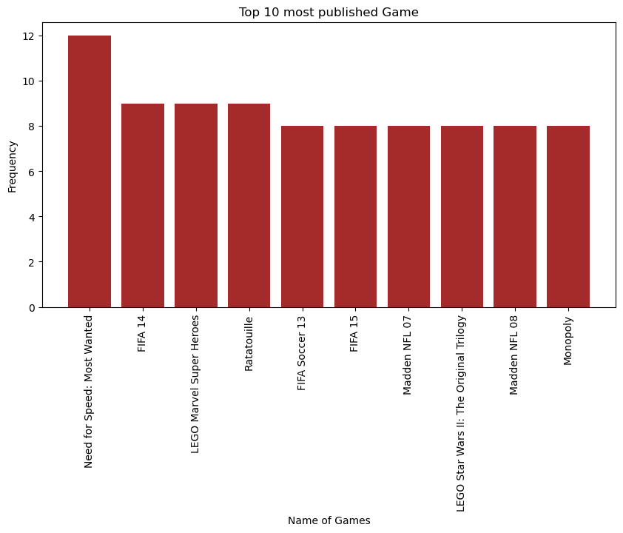
Top 10 most published game

Slide 17
Top 10 games in terms of sales
Name | NA Sales | EU Sales | JP Sales | Other Sales | Global Sales
Wii Sports | 41.49 | 29.02 | 3.77 | 8.46 | 82.74
Grand Theft Auto V | 23.46 | 23.04 | 1.39 | 8.03 | 55.92
Super Mario Bros. | 32.48 | 4.88 | 6.96 | 0.99 | 45.31
Tetris | 26.17 | 2.95 | 6.03 | 0.69 | 35.84
Mario Kart Wii | 15.85 | 12.88 | 3.79 | 3.31 | 35.82
Wii Sports Resort | 15.75 | 11.01 | 3.28 | 2.96 | 33.00
Pokémon Red/Pokémon Blue | 11.27 | 8.89 | 10.22 | 1.00 | 31.37
Call of Duty: Modern Warfare 3 | 15.58 | 11.29 | 0.62 | 3.35 | 30.83
New Super Mario Bros. | 11.38 | 9.23 | 6.50 | 2.90 | 30.01
Call of Duty: Black Ops II | 14.08 | 11.05 | 0.72 | 3.88 | 29.72

Slide 18
Insight from the data
From our analysis, North America market generates the highest sales as compared to other markets.
Most games was published in the year 2009 and least games were published in 2020 and we think it is as a result of the covid-19 pandemic where at that time, business activities were not much.
Our analysis revealed that the best genre loved by customers is the action genre which generate a global sales of something above 1.7 billion over the period

Slide 19
Insight from the data
Our analysis also revealed PS 2 as the platform that generates the highest sales of 1.23 billion and DS as the most used platform for publishing.
Nintendo was the publisher with the highest sales from our analysis. It generated a global sales of 1.78 billion.
Wii Sports is the game that generated the highest sales among all the games published over the period.

Slide 20
Conclusion
From our visualizations and analysis, we observed that the sales generated is not dependent on the rank of the games.
Therefore we conclude that the sales generated may be influenced by some factors such as the taste and preference of consumers, the size of the market and the popularity of the platform, publisher, and the genre.

Slide 21
THANK YOU

